Slide 1
Basic Network Concepts
- Layer 2 -

Slide 2
Agenda
Limitations of Layer 1
Layer 2 introduction
IEEE LAN Standard
MAC addressing
Ethernet framing
Media access control
Layer 2 devices
Full-duplex and half-duplex links
LAN segmentation
Spanning Tree Protocol introduction
Virtual LAN introduction
Some other advanced features

Slide 3
Limitations of Layer 1
Send and receive bits.
Cannot organize streams of bits.
Cannot name or identify computers.
Cannot communicate with the upper-level layers.
Cannot decide which computer will transmit binary data.

Slide 4
Layer 2 introduction
Layer 2 uses framing to organize or group the bits.
Ensures that the correct recipient receives and processes the data that is sent.
Determines when it is appropriate to use the physical medium.
Determines whether the data made the trip across the physical medium successfully
Determines the type of header that follows the data link header

Slide 5
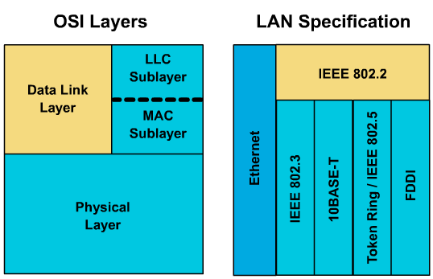
IEEE LAN Standard (1)

Slide 6
IEEE LAN Standard (2)
LLC serves to communicate upward to Network layer, independent of the specific LAN technology used and Upper layer.
MAC serves to access and communicate downward to the technology-specific Physical layer.

Slide 7
MAC addressing (1)
Every computer has a unique way of identifying itself : MAC address or physical address.
The physical address is located on the Network Interface Card (NIC).
MAC addresses have no structure, and are considered flat address spaces.

Slide 8
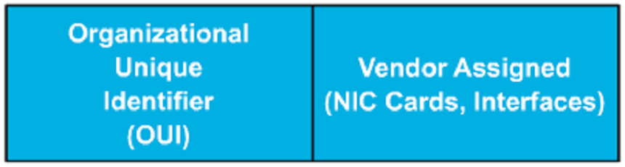
MAC addressing (2)
The remaining six hexadecimal digits comprise the interface serial number.
The first six hexadecimal digits, which are administered by the IEEE, identify the manufacturer or vendor.

Slide 9
MAC addressing (3)
MAC addresses are sometimes referred to as burned-in addresses (BIAs) because they are burned into read-only memory (ROM) and are copied into random-access memory (RAM) when the NIC initializes.
0000.0c12.3456 or 00-00-0c-12-34-56.
Visit the URL to look for OUI assignment
  http://standards.ieee.org/regauth/oui/oui.txt

Slide 10
MAC addressing (4)
Three type of MAC address
  Unicast address: identifies an individual LAN interface card.
  Broadcast addresses: “all devices that reside on this LAN right now.” → FFFF.FFFF.FFFF
  Multicast address: identifies a subset of devices on a LAN → 0100.5exx.xxxx

Slide 11
Ethernet framing (1)
Framing defines the meaning behind the bits that are transmitted across a network.
There are many different types of frames described by various standards.

Slide 12
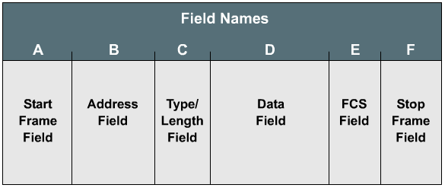
Ethernet framing (2)
Generic frame format

Slide 13
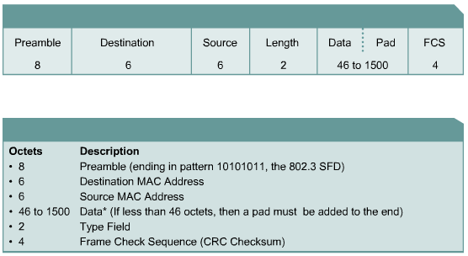
Ethernet framing (3)
Ethernet (DIX)

Slide 14
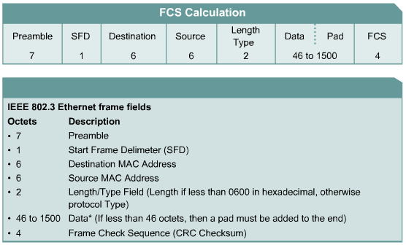
Ethernet framing (4)
IEEE Ethernet (802.3)

Slide 15
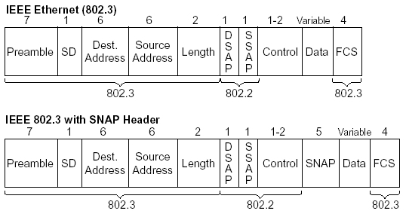
Ethernet framing (5)
IEEE 802.3 with SNAP Header

Slide 16
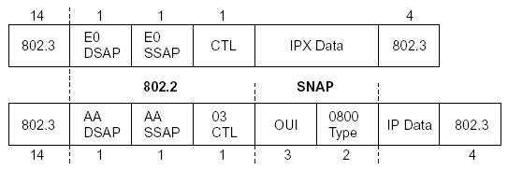
Ethernet framing (6)
Identifying the Data Inside an Ethernet Frame
  Protocol Type (2 bytes) – DIX Ethernet
  DSAP (1 byte) – IEEE 802.2
  SNAP Protocol Type (2 bytes) – IEEE 802.2 with SNAP header

Slide 17
Media access control (1)
Specified by the technology being used.
Determine who can transmit and when.
Two types:
  Deterministic: “Let’s take turns”.
    Token-Ring, FDDI.
  Non-deterministic: “First come, first serve”.
    Ethernet : CSMA/CD.

Slide 18
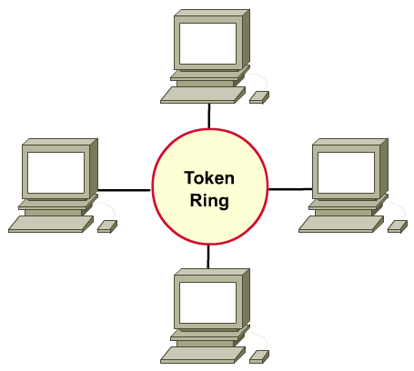
Media access control (2)
Deterministic MAC protocol

Slide 19

Media access control (3)
Non-deterministic MAC protocol
  Carrier Sense Multiple Access with Collision Detection (CSMA/CD).

Slide 20
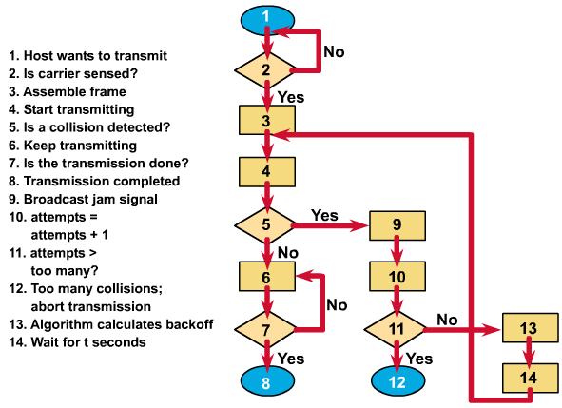
Media access control (4)
CSMA/CD

Slide 21
Identifying the Data Inside an Ethernet Frame
Protocol Type (2 bytes) – DIX Ethernet
DSAP (1 byte) – IEEE 802.2
SNAP Protocol Type (2 bytes) – IEEE 802.2 with SNAP header

Slide 22
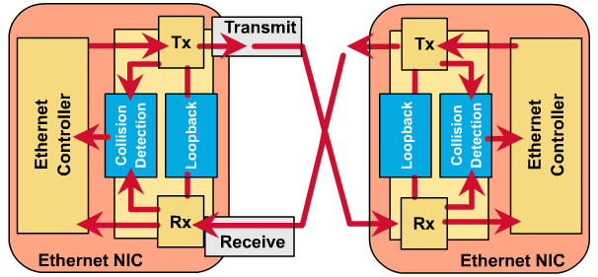
Layer 2 devices (1)
NIC (Network Interface Card) (1)

Slide 23
Layer 2 devices (2)
NIC (Network Interface Card) (2)
  Provides ports for network connection.
  When selecting a network card, consider:
    Type of network:
      Ethernet
      Token Ring
      FDDI
    Type of media
      Twisted-pair
      Coaxial
      Fiber-optic
    Type of system bus
      PCI
      ISA

Slide 24
Layer 2 devices (3)
Bridge (1)
  Connects network segments.
  Make intelligent decisions about whether to pass signals on to the next segment.
  Improve network performance by eliminating unnecessary traffic and minimizing the chances of collisions.
  Devides traffic into segments and filters traffic based on MAC address.
  Learning & forwarding process.

Slide 25
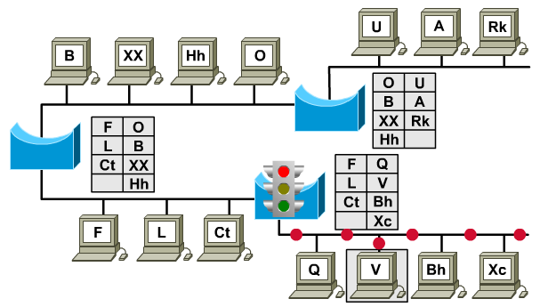
Layer 2 devices (4)
Bridge (2): Filter

Slide 26
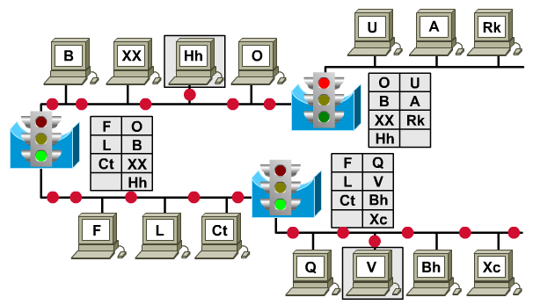
Layer 2 devices (4)
Bridge (3): Forward

Slide 27
Layer 2 devices (5)
LAN Switch (1)
  Switches connect LAN segments.
  LAN switches are considered multi-port bridges with no collision domain.
  Use a MAC table to determine the segment on which a frame needs to be transmitted.
  Switches often replace shared hubs and work with existing cable infrastructures.
  Higher speeds than bridges.
  Support new functionality, such as VLAN.

Slide 28
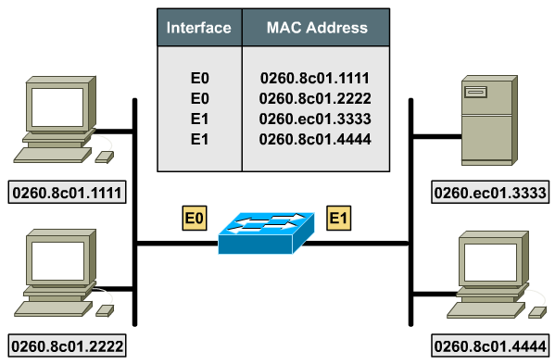
Layer 2 devices (6)
LAN Switch (2): MAC table

Slide 29
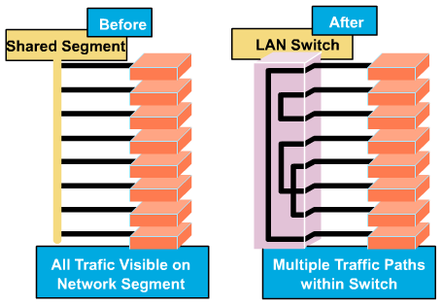
Layer 2 devices (7)
LAN Switch (3): micro-segmentation

Slide 30
Layer 2 devices (8)
LAN Switch (3): Benefits
  No collision domain, because of micro-segmentation.
  Low latency levels and a high rate of speed for frame forwarding
  Increases the bandwidth available on a network
  Is performed in hardware instead of in software, it is significantly faster.

Slide 31
Full-duplex and half-duplex links
Two types of link
  Shared link: PC-HUB, HUB-HUB, SW-HUB, …
  Point-to-point link: PC-PC, PC-SW, SW-SW, …
Loopback circuit and CSMA/CD
Half-duplex links: turn CSMA/CD on → shared links → shared bandwidth.
Full-duplex links: turn CSMA/CD off → ptp links → dedicated bandwidth.

Slide 32
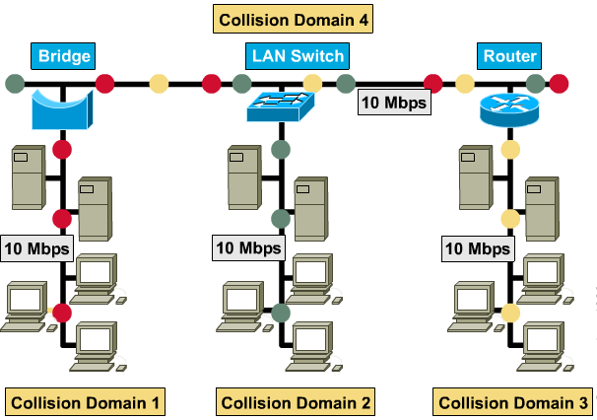
LAN Segmentation (1)

Slide 33
LAN Segmentation (2)
Why segment LANs?
  Isolate traffic between segments.
  Achieve more bandwidth per user by creating smaller collision domains.
  LANs are segmented by devices like bridges, switches, and routers.
  Extend the effective length of a LAN, permitting the attachment of distant stations.

Slide 34
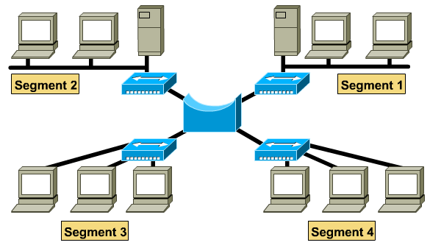
LAN Segmentation (3)
Segmentation with bridges (1)

Slide 35
LAN Segmentation (4)
Segmentation with bridges (2)
  Bridges increase the latency (delay) in a network by 10-30%.
  A bridge is considered a store-and-forward device because it must receive the entire frame and compute the cyclic redundancy check (CRC) before forwarding can take place.
  The time it takes to perform these tasks can slow network transmissions, thus causing delay.

Slide 36
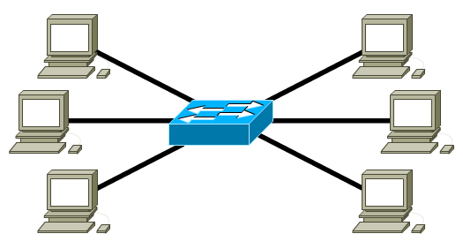
LAN Segmentation (5)
Segmentation with switches (1)

Slide 37
LAN Segmentation (6)
Segmentation with switches (2)
  Allows a LAN topology to work faster and more efficiently.
  Uses bandwidth so efficiently, the available bandwidth can reach to 100%.
  Ease bandwidth shortages and network bottlenecks (such as client-server).
  A computer connected directly to an Ethernet switch is its own collision domain and accesses the full 10Mbps.

Slide 38
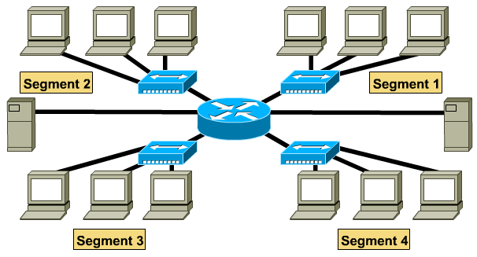
LAN Segmentation (7)
Segmentation with routers (1)

Slide 39
LAN Segmentation (8)
Segmentation with routers (2)
  Routers operates at the network layer.
  Routers bases all of its forwarding decisions on the Layer 3 protocol address.
  Routers ability to make exact determinations of where to send the data packet.
  Router operate with a higher rate of latency.

Slide 40
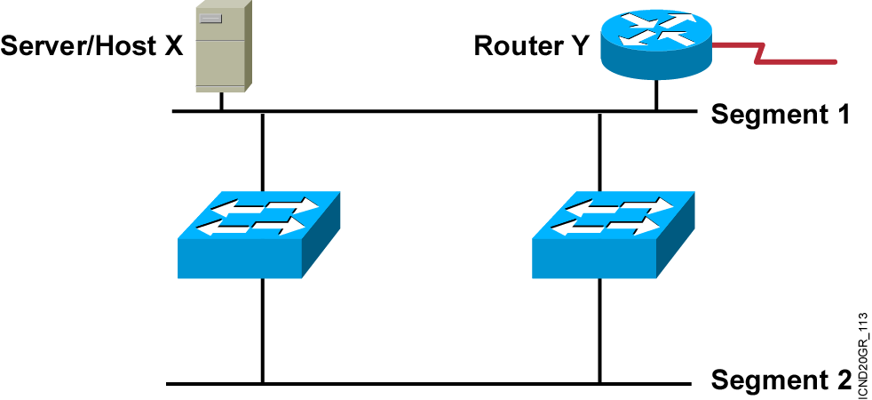
Spanning Tree Protocol (1)
Redundant Topology (1)
  Redundant topology eliminates single points of failure.
  Redundant topology causes broadcast storms, multiple frame copies, and MAC address table instability problems.

Slide 41
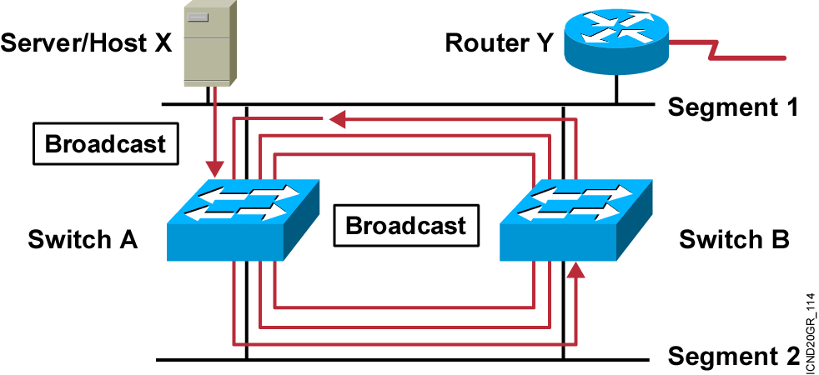
Spanning Tree Protocol (2)
Redundant Topology (2): Broadcast Storms
  Host X sends a broadcast.
  Switches continue to propagate broadcast traffic over and over.

Slide 42
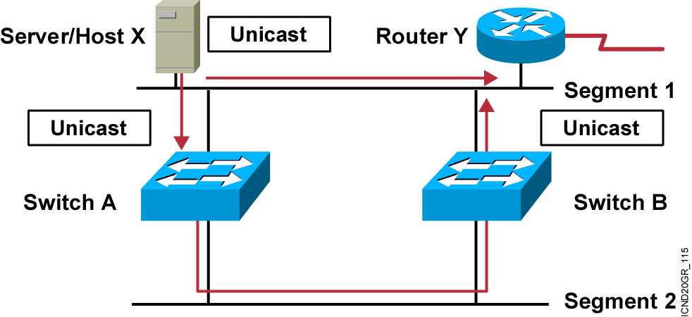
Spanning Tree Protocol (3)
Redundant Topology (3): Multiple Frame Copies
  Host X sends a unicast frame to router Y.
  MAC address of router Y has not been learned by either switch yet.
  Router Y will receive two copies of the same frame.

Slide 43
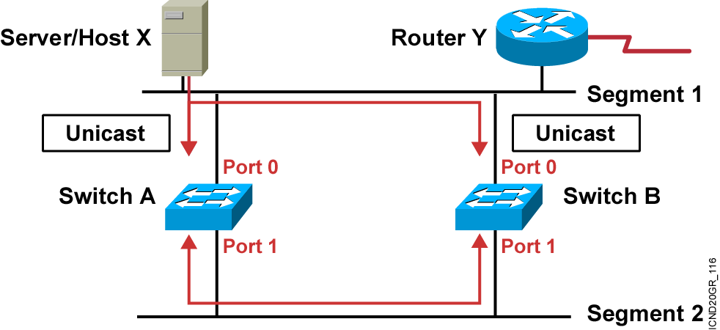
Spanning Tree Protocol (4)
Redundant Topology (4): MAC Database Instability
  Host X sends a unicast frame to router Y.
  MAC address of router Y has not been learned by either switch.
  Switches A and B learn the MAC address of host X on port 0.
  The frame to router Y is flooded.
  Switches A and B incorrectly learn the MAC address of host X on port 1.

Slide 44
Spanning Tree Protocol (5)
STP is a bridge-to-bridge protocol used to maintain a loop-free network.
STP establishes a root bridge, a root port, and designated ports.
With STP, the root bridge has the lowest bridge ID, which is made up of the bridge’s priority and MAC address.
With STP, ports transition through four states: blocking, listening, learning, and forwarding.
If a change occurs to the network topology, STP maintains connectivity by transitioning some blocked ports to the forwarding state.
RSTP significantly speeds the recalculation of the spanning tree when the network topology changes.

Slide 45
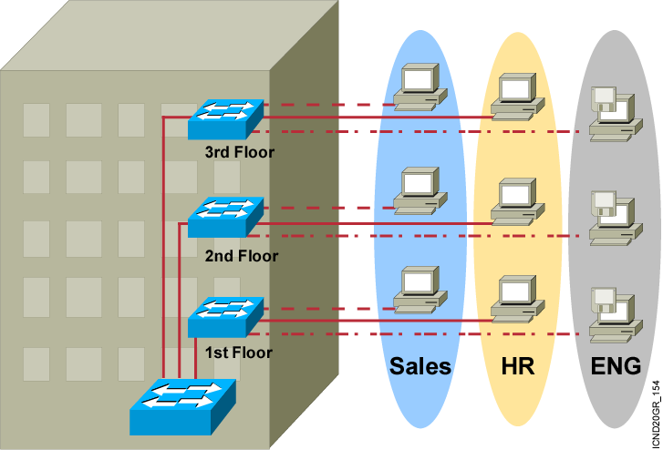
VLAN & 802.1q Trunking (1)
VLAN Overview
A VLAN = A Broadcast Domain = Logical Network (Subnet)

Slide 46
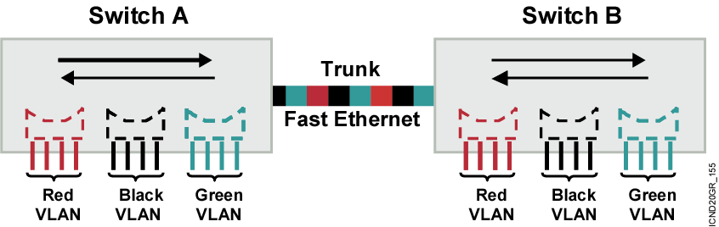
VLAN & 802.1q Trunking (2)
VLAN Operation
  Each logical VLAN is like a separate physical bridge.
  VLANs can span across multiple switches.
  Trunks carry traffic for multiple VLANs.
  Trunks use special encapsulation to distinguish between different VLANs.

Slide 47
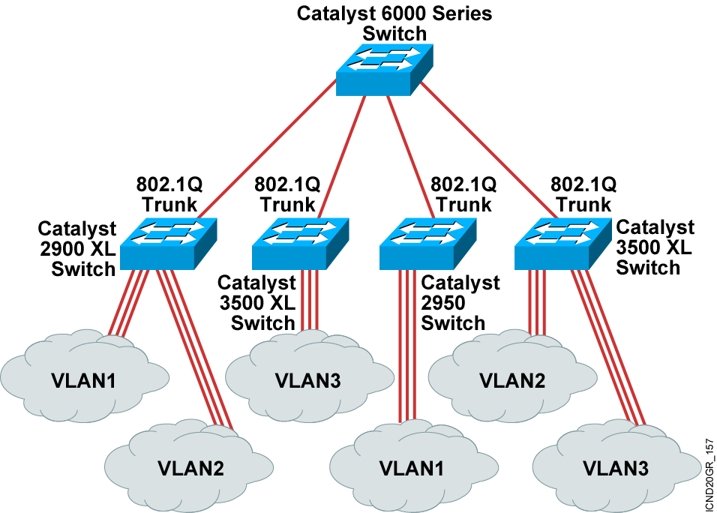
VLAN & 802.1q Trunking (3)
802.1q Trunking

Slide 48
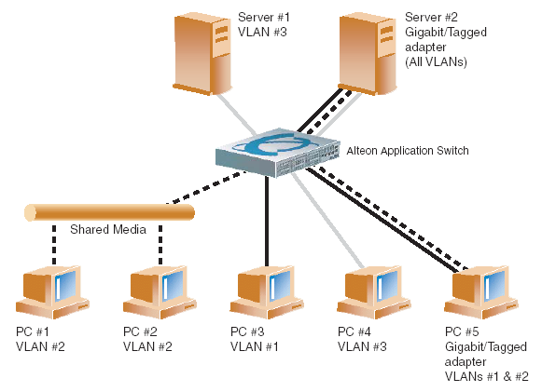
VLAN & 802.1q Trunking (4)
Multiple VLANS with Tagging Adapters

Slide 49
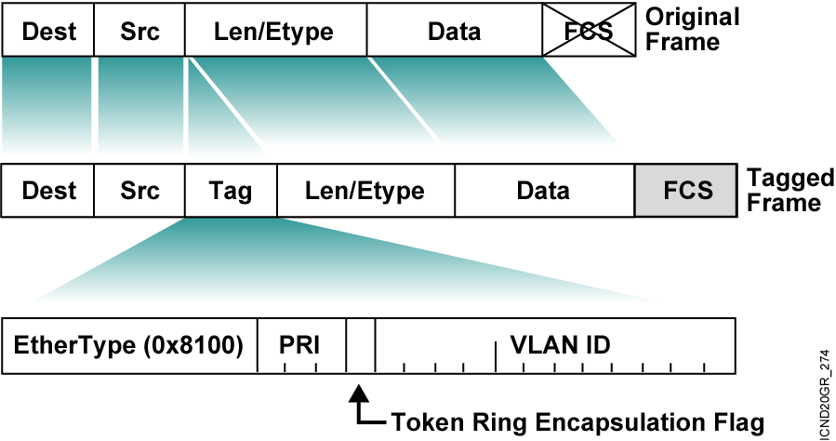
VLAN & 802.1q Trunking (5)
802.1Q Frame

Slide 50
Some other advanced features (1)
Jumbo frame
  A proposal of Alteon Networks.
  Reduces frame processing overhead by extending frame size to over the traditional size.
  The popular size is around 9000 octets
    Ethernet uses a 32 bit CRC that is effective below 12000 octets.
    It is large enough to carry a 8KB datagram (e.g. NFS)
  Alteon switches support jumbo frame sizes up to 9014 octets (excluding CRC) and use only on uplink ports.

Slide 51
Some other advanced features (2)
Link Aggregation Control Protocol – LACP
  IEEE 802.3ad
  Group several physical ports into one logical port (known as trunk group or Link Aggregation group)
  Is similar to Cisco Ether Channel technology
  Member link must have the same media type and speed in full-duplex.
  Use Link Aggregation Identifier (LAG ID), which is constructed from system ID and port’s admin key, to determine how the port can be aggregated

Slide 52
! uoy knahT

